Slide 1

An event-based IEEE 802.11ax WLANs Simulator
Sergio Barrachina-Muñoz, Francesc Wilhelmi

Slide 2
Introduction

Slide 3
Introduction to the simulator
Open source, available at https://github.com/wn-upf/Komondor
Based on COST
Implementation of IEEE 802.11ax novel functionalities
High-density scenarios
Prepared to handle intelligent agents
Documentation:
Tutorial at https://github.com/wn-upf/Komondor/blob/master/Documentation/Tutorial/LaTeX%20files/komondor_technical_report.pdf
Technical report at https://github.com/wn-upf/Komondor/blob/master/Documentation/Technical%20Report/LaTeX%20files/komondor_technical_report.pdf

Slide 4
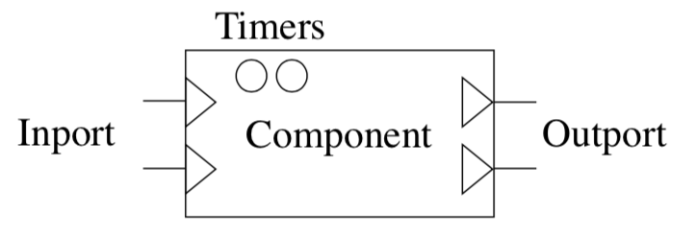
COST
CompC++ library that allows generating discrete event simulations
Main website: http://www.ita.cs.rpi.edu/cost.html
Nodes are represented by components
Message exchange between nodes through outport/inport connections
Timers for triggering events (e.g., end of transmission)
Fig. 1: Component in COST

Slide 5
Overview
Fig. 2: Komondor flowchart

Slide 6
IEEE 802.11 Features

Slide 7
Channel Access
Distributed Coordination Function (DCF): Carrier Sense Multiple Access with Collision Avoidance (CSMA/CA) with Binary Exponential Backoff (BEB)
Slotted vs Continuous Backoff (BO)
Uniform vs Exponential distributions for BO calculation
Capture Effect (CE): stronger-first approach
Fig. 3: Capture Effect approach

Slide 8
RTS/CTS
Ready-To-Send/Clear-To-Send (RTS/CTS) is mandatory
Virtual carrier sensing is done
Fig. 4: RTS/CTS utilization example

Slide 9
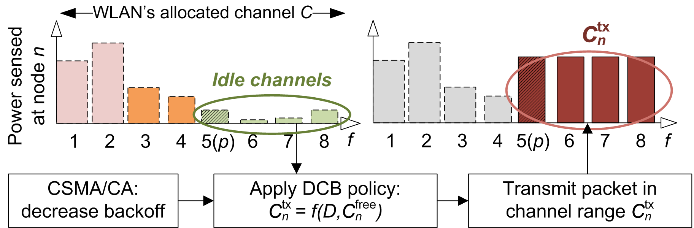
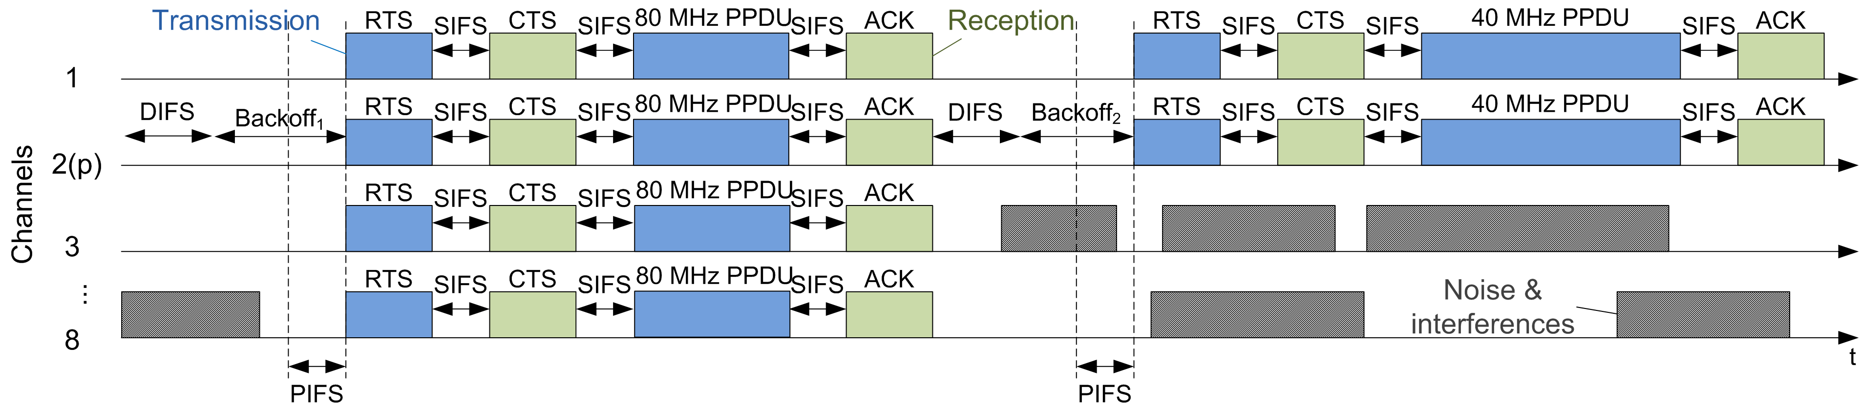
Channel Bonding
Several implemented policies:
Only Primary (OP)
Static Channel Bonding (SCB):
Always-max (AM)
Probabilistic uniform (PU)
Fig. 5: Channel access when AM is applied
Fig. 6: CSMA/CA temporal evolution under the utilization of AM

Slide 10
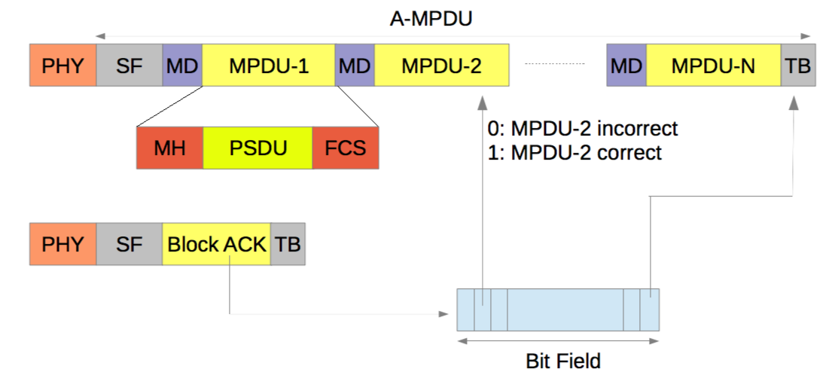
Packet Aggregation
Concatenation of N MPDUs to be sent over the same packet transmission
Acknowledged by a Block-ACK (BACK)
Fig. 7: Packet aggregation for a single transmission

Slide 11
Design Principles

Slide 12
Architecture based on states
The IEEE 802.11ax-based Simulator considers several states to capture the behavior of nodes
Sensing
NAV
Transmitting an RTS or a CTS
Receiving an RTS or a CTS
Transmitting DATA
Receiving DATA
…

Slide 13
Channel Modeling
Several Path-loss models (easy to add new ones):
Free Space Path Loss (FSPL)
Okumura-Hata model
Generic indoor model
IEEE 802.11ax residential scenario model
Different adjacent channel interference models:
No interference
Limited interference: only adjacent channels leak power
Total interference: all the channels leak power (20 dB per channel)
Assumption: the incoming power in a given receiver is assumed to be the same during the entire transmission

Slide 14
Traffic Modeling
Three implemented models for traffic generation:
Fig. 8: Traffic generation models

Slide 15
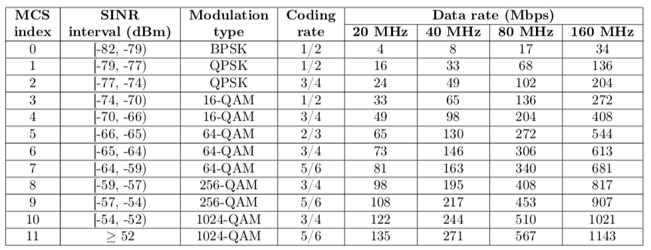
Link Modeling
IEEE 802.11ax MCS are used
Tbl. 1: IEEE 802.11ax MCS table
Assumption: The MCS is computed at the beginning of the simulation, based on the power received from the transmitter

Slide 16
Collisions Modeling
Packet losses occur if:
The destination is already transmitting
The signal strength is not strong enough (P_{rx} < CCA)
The CE is not accomplished due to interference
The destination is already receiving a packet and the CE condition is still accomplished for the first transmission
The destination is in NAV
Backoff collisions

Slide 17
Validations

Slide 18
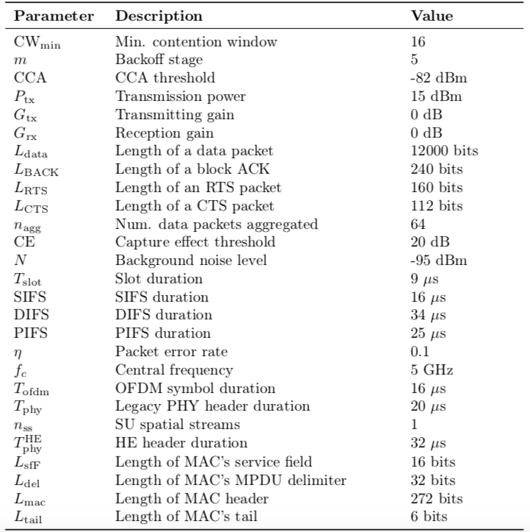
System parameters
IEEE 802.11ax parameters are considered
Channel access
Frames length
Channelization
…
Tbl. 2: IEEE 802.11ax PHY & MAC parameters

Slide 19
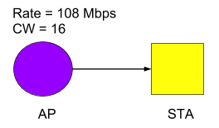
Basic Operation
Scenario
Results
Packet aggregation (N = 64)
Komondor | ns3 | Bianchi
91.45 Mbps | 90.71 Mbps | 91.44 Mbps
Single packet (N = 1)
Komondor | ns3 | Bianchi
26.87 Mbps | 25.28 Mbps | 26.87 Mbps
Fig. 9: Scenario 1
 | Position AP (m) | Position STA (m) | Channel | Transmit power (dBm) | CCA (dBm)
AP | [2,2,0] | - | 1 | 20 | -68
STA A | - | [0,0,0] | 1 | 20 | -68
Tbl. 4: Results Scenario 1
Tbl. 3: Configuration Scenario 1

Slide 20
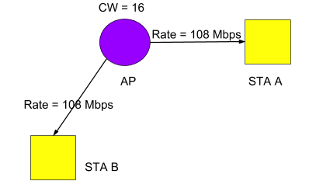
Two STAs
Scenario
Results
Packet aggregation (N = 64)
Komondor | ns3 | Bianchi
91.45 Mbps | 90.71 Mbps | 91.44 Mbps
Single packet (N = 1)
Komondor | ns3 | Bianchi
26.87 Mbps | 25.28 Mbps | 26.87 Mbps
Fig. 9: Scenario 2
 | Position AP (m) | Position STA (m) | Channel | Transmit power (dBm) | CCA (dBm)
AP | [2,2,0] | - | 1 | 20 | -68
STA A | - | [0,0,0] | 1 | 20 | -68
STA B | - | [4,4,0] | 1 | 20 | -68
Tbl. 6: Results Scenario 2
Tbl. 5: Configuration Scenario 2

Slide 21
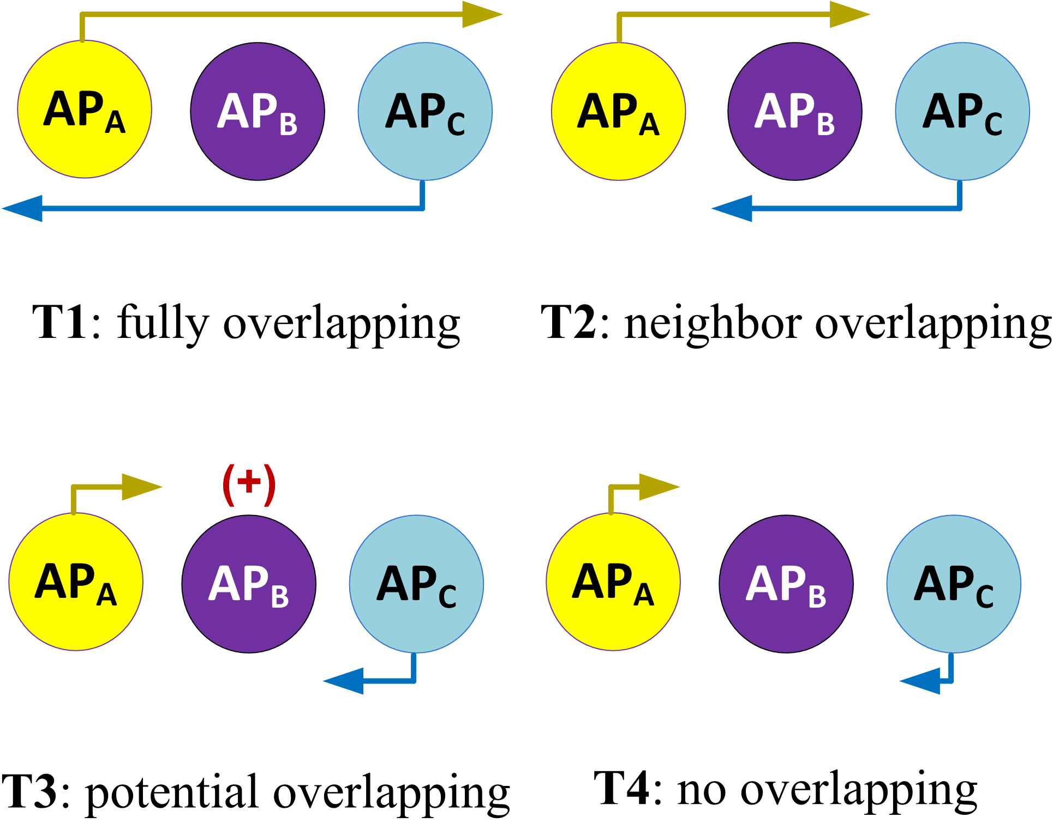
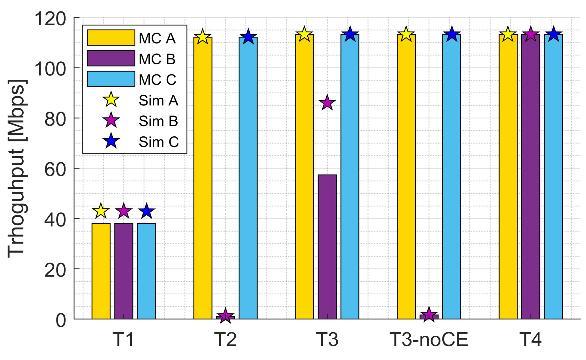
Dynamic Channel Bonding
Scenarios
Results
Fig. 10: Scenarios for DCB validation
Fig. 11: Results DCB validation
More information in Barrachina-Munoz, S., Wilhelmi, F., & Bellalta, B. (2018). Performance Analysis of Dynamic Channel Bonding in Spatially Distributed High Density WLANs. arXiv preprint arXiv:1801.00594.

Slide 22
Intelligent Agents

Slide 23
Some remarks
Agents are introduced to modify the configuration of simulated WLANs in order to maximize a certain performance metric (local or globally)
Each agent is associated to an AP, so that all the information is shared between these two type of entities (we assume that the agent is located in the AP)
Communication between agents is not implemented yet, but future developments contemplate centralized approaches
Agents share information with a central entity, which takes decisions
Adaptive delay for such a communication

Slide 24
Overview
Central Entity
Centralized Learning
Decentralized Learning
Legacy
Centralized Learning
Centralized Learning
Legacy
Decentralized Learning

Slide 25
AP-Agent communication
Function
Outport
Inport
ouportRequestInformationToAp()
Agent:: RequestInformationtoAp()
inportReceivingRequestFromAgent()
Node :: GenerateConfiguration()
Node :: GeneratePerformanceReport()
ouportAnswerToAgent()
inportReceivingInformationFromAp()
Agent:: GenerateRewardSelectedArm()
Agent:: ComputeNewConfiguration()
ouportSendConfigurationToAp()
Agent:: SendNewConfigurationToAp()
Node :: ApplyNewConfiguration()
inportReceiveConfigurationFromAgent()
t
t

Slide 26
Agent-oriented functionalities at the AP
Wait for agent requests → inportReceivingRequestFromAgent() ouportRequestInformationToAp()
Encapsulate important information regarding the current configuration (transmit power, CCA, MCS…) and the offered performance (packets sent, packets lost, collisions by hidden node…) → GenerateConfiguration() GeneratePerformanceReport()
Send information to the Agent → ouportAnswerToAgent()
Wait for the new configuration granted by the Agent → inportReceiveConfigurationFromAgent()
Apply changes and broadcast new configuration to STAs → ApplyNewConfiguration()

Slide 27
Agent functionalities
Generate and send requests for APs periodically → RequestInformationtoAp() ouportRequestInformationToAp()
Wait for the requested information → inportReceivingInformationFromAp()
Generate a reward according to the current configuration and performance in the AP → GenerateRewardSelectedArm()
Draw a new configuration according to updated rewards → ComputeNewConfiguration()
Send the new configuration to the AP → SendNewConfigurationToAp()
ouportSendConfigurationToAp()

Slide 28
Centralized Learning - Remarks
In order to perform centralized learning, we have added a central entity that controls the operations done by agents
The central entity works on the top of the Agent-AP operation
It is important to remark that agents can be freely assigned to the central entity, so that we can support hybrid scenarios with
Legacy APs
Agent-embedded APs
Centralized agent-embedded APs
Each agent communicates to the centralized entity in a synchronized manner

Slide 29
Agent-Central Entity (CC) communication
Function
Outport
Inport
ouportRequestInformationToAgent()
CentralController :: RequestInformationtoAgent()
inportReceivingRequestFromController()
Start request of information to the AP
ouportAnswerToController()
CentralController CentralController :: GenerateRewardSelectedArm()
inportReceivingInformationFromAgent()
CentralController :: ComputeNewConfiguration()
ouportSendConfigurationToAgent()
CentralController :: SendNewConfigurationToAgent()
Forward the new configuration to the AP
inportReceiveConfigurationFromController()
t
t

Slide 30
Agent-embedded Architecture
Central Entity
Access Point
Agent
Current Operation
Communication with AP
Communication with CE
Retrieve information from agents
MAC
PHY
Algorithm
Algorithm
Process Input
Process Input
Performance Report Generation
ConfigurationReport Generation
Update configuration
Generate Global Configuration
Generate new configuration
Receive new configuration from CE
Update Configuration

